Slide 1

Power & integrity
About the good, the bad and the ugly
Wilfried Cools
Interfaculty Center Dataprocessing and Statistics

Slide 2
Power: probability to detect the assumed effect
Just one way of putting it
Notes:
1

Slide 3
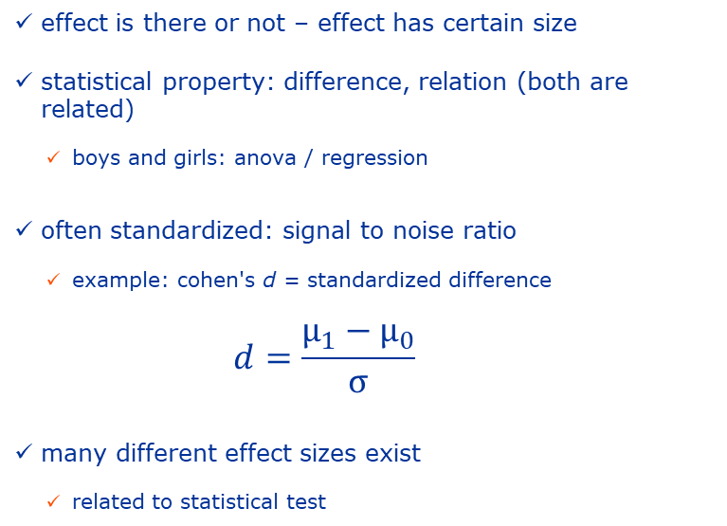
Effect and effect Size
probability to detect the assumed effect
probability to detect the assumed effect
effect is there or not – effect has certain size
statistical property: difference, relation (both are related)
boys and girls: anova / regression
often standardized: signal to noise ratio
example: cohen's d = standardized difference
$$d=\frac{μ_{1}−μ_{0}}{σ}$$
many different effect sizes exist
related to statistical test
Notes:
5 (6)

Slide 4
DETect effects
probability to detect the assumed effect
statistical testing (inference)
reject Null-hypothesis: how likely that Null holds
depends on effect size
alternative: statistical estimation → accuracy: confidence intervals
related: difference gains power if more accurate
standard error → sample size
gets complex or impossible for complex models → simulation
impossible / very different for predictive modelling, time series, ..., Bayesian statistics
Notes:
4 (10)

Slide 5
probability
probability to detect the assumed effect
probability, is a continuum between 0 and 1
given a specific effect to find, probability to detect it
if no effect, detect one is error, type I (α)
.05 → 1/20 if no effect, still say there is
if effect, not detect it, type II error (β)
1-power → .2 for power of .8
balance .2/.05 ~ 4 → relative severity
Notes:
4 (14)

Slide 6
conditional probability
probability to detect the assumed effect
effect which is assumed ?
not known effect: not after the data collected
not just any effect, it matters: easy to find big effects
how big ?
rules of thumb, don't
same as in pilot, but too small, ok for standard deviation (within variability)
same as in literature, but may be too big
informed decision → minimal difference to be relevant
difficult, maybe impossible
easier if confirmatory - less so if exploratory
easier if experimental - less so if observational
Notes:
7 (21)

Slide 7
probability to detect the assumed effect
Say that again
power is based on assumptions, and strongly depends on assumptions
sizes: sample size & effect size
errors: type I and type II (1-power)
assume/choose 3, get the 4th
for many studies assumptions are very approximate at best
power or sample size approximate at best
why is it so popular
given that it is technically challenging
given that in most cases it only is very approximate
what it means for research integrity
Notes:
1 (22)

Slide 8
power & integrity
WHY would you ?
power, to ensure your efforts / investment will pay off
if wrong, typically because poorly understood (most do not)
power, most often to convince others
research committee: to suggest quality of research
just small part of it, based on different quality assumptions
funding body: to justify costs (money + time as cost)
overestimate power / too low sample size → get approval
underestimate power / too high sample size → get more money, ...
ethical committee: to justify necessity (ethical cost) → get approval
for others, then lying is rewarded → threat for integrity
Notes:
4 (26)

Slide 9
power & integrity
HOW could you ?
lying is easy: sample size samba
primary research question
transfer the difficult stuff to the secondary's
focus on the easy stuff
effect size (signal - noise)
look for big/small enough differences - relations
choose variances wisely
one-two sided, assume drop-out, ...
lying is easy: your reviewers / referees do not understand either
just pretend you know what you are doing
Notes:
2 (28)

Slide 10
power & integrity
Asking for it
often poorly understood by reviewers/referees but still they insist
often it is not meaningful but still they insist
journals exist that include power calculations in the actual articles
not relevant when data is analyzed (collected)
my thought on why:
looking for certainty where there is none
continuum instead of cut-off
similar fetish like for p-values
copying others without understanding
Notes:
3 (31)

Slide 11
power & integrity
Wrapping up
power can be of real interest (good), although not as much as often believed
power then often is about selling yourself, not about getting the right amount of data to answer your question (bad)
where selling yourself is the key, integrity is challenged as researchers get tempted to lie (ugly)
power is just a tool, to be used when of interest only,
unless your reviewer or referee - who doesn’t get it - insists
Notes:
1 (32)

Slide 12


Thank you up for questions

